Slide 1
Naan Mudhalvan Project
PREDICTING AIR QUALITY LEVELS
USING ADVANCED MACHINE LEARNING ALGORITHMS FOR ENVIRONMENTAL INSIGHTS
SUBMITTED BY
MEENAKSHI SUNDARAM R - 412323104306
NANTHITHA K - 412323104307
GOPIKRISHNAN J – 412323104303
PARANTHAMAN - 412323104308

Slide 2

TABLE OF CONTENTS
01
02
03
PHASE 1
PAHSE 2
PAHSE 3
Early Stages of the Project.
Basic Implementation.
Final Deployment.

Slide 3



PHASE 1
OBSERVE THE PROBLEM
Understand the problem first.
FORMULATE SOLUTION
List out potential solutions and shortlist a few.
TEST IMPLEMENTATION
Code the solution and evaluate its accuracy.

Slide 4





ABOUT PAHSE 1
DATA PREPROCESSING
MODEL DEVELOPMENT
MODEL EVALUATION
Clean and prepare the dataset for machine learning.
Handle missing values and normalize
environmental features.
Ensure data consistency for model training.
Build a linear regression model using Python.
Train the model with historical environmental data.
Predict future air quality levels.
Evaluate prediction accuracy using:
Root Mean Squared Error (RMSE)
R² Score for performance assessment
Visualize results for better understanding.

Slide 5




PHASE 2
ROBUST PREPROCESSING
POLLUTION TREND ANALYSIS
MODEL EVALUATION
FEATURE IMPORTANCE

Slide 6
ABOUT PHASE 2
ROBUST DATA PREPROCESSING
POLLUTION TREND ANALYSIS
.
Handle missing values and clean the dataset.
Combine Date and Time into a single Date Time field.
Prepare data to predict CO, C6H6, NOx, NO2 concentrations.
Remove noise by aggregating hourly data to daily averages.
Explore pollutant level patterns over time.
Identify seasonal variations in temperature and pollution.
Observe high correlation between NOx and NO2.
Detect peak pollution periods (e.g., evening traffic hours).
MODEL EVALUATION & METRICS
FEATURE IMPORTANCE
Apply regression models: Linear Regression, Random Forest.
Use metrics: Mean Absolute Error (MAE), Root Mean Squared
Error (RMSE), and R² Score.
Split dataset into 80% training and 20% testing.
Identify key influencing features like Temperature and Humidity.
Recognize traffic-related patterns in pollution levels.
Use Random Forest to assess feature significance.

Slide 7
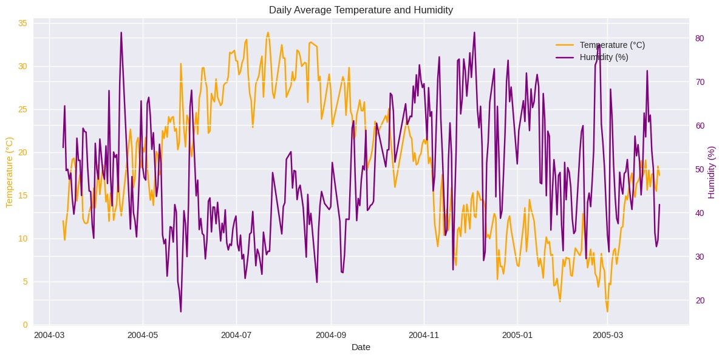
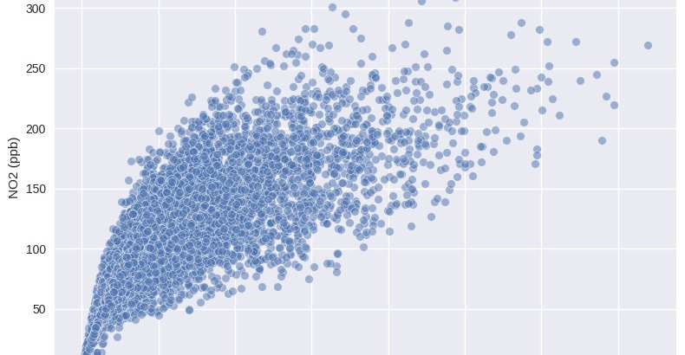
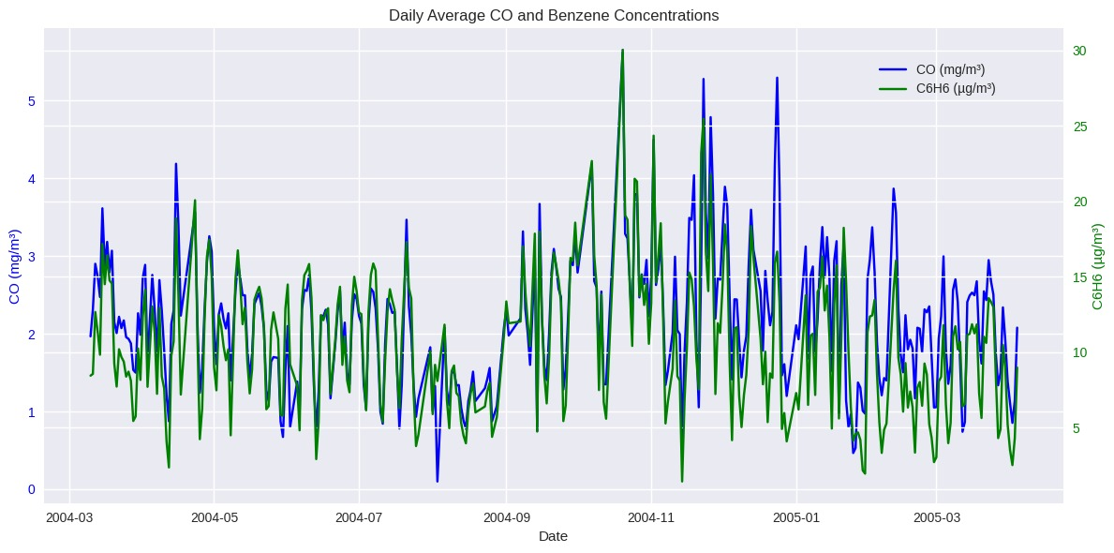
Visualization of Results & Model Insights
Time-series plots of pollutants (CO and C6H6).
Time-series plots of pollutants (CO and C6H6).
Temperature vs Humidity Trends: Visualized via dual-axis plots.

Slide 8




MODEL UPGRADE
PHASE 3
Upgraded models were used
DEPLOYMENT SHIFT
DATA BALANCING
Introduced with SMOTE
Changed the type of Deployment
PHASE 3
UI/UX DESIGN
DATASET ENHANCEMENT
Design was improved
Upgraded the Dataset.
HOSTING AND SCALABILITY
Model scalability was increased

Slide 9
PHASE 3
MODEL UPGRADE
DATA BALANCING
Used advanced ML models: Random Forest, Gradient Boosting, SVR.
Compared models using RMSE, MAE, and R² metrics.
Selected the best-performing model for real-time deployment.
Built Streamlit app for a user-friendly prediction interface.
Cleaned missing values and handled outliers with domain-specific limits.
Normalized environmental features for consistent model input.
Added temporal features (hour, day) to enhance prediction accuracy.
Improved data quality for trend detection and reporting.

Slide 10
PHASE 3
DATASET ENHANCEMENT
HOSTING
Phase 2: Used an AI-generated air quality dataset.
Phase 3: Switched to real-world dataset from UCI repository (cleaned_air_quality.csv).
Change: Improved realism, temporal consistency, and pollutant coverage for better model reliability.
Phase 2: Local model testing using Google Colab.
Phase 3: Deployed interactive prediction app using.
Change: Streamlit-enabled real-time public access with a clean UI and predictive visualizations.

Slide 11
PHASE 3
DEPLOYMENT
UI / UX
Phase 2: Used Local GUI with tkinter.
Phase 3: Fully deployed Flask-based web app for real-time prediction.
Change: Made the project scalable and accessible via the web.
Phase 2: Basic, cluttered interface with limited usability.
Phase 3: Redesigned clean web UI using HTML/CSS with structured output.
Change: Greatly improved professionalism and user experience.

Slide 12
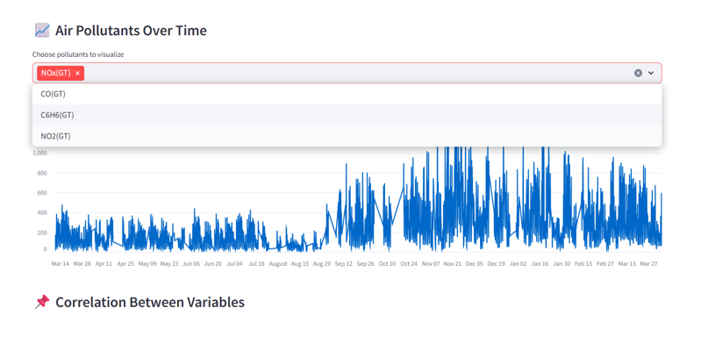
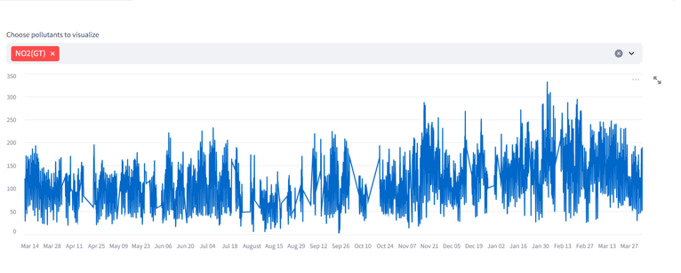
Application Link: Air Quality Prediction Application

Slide 13
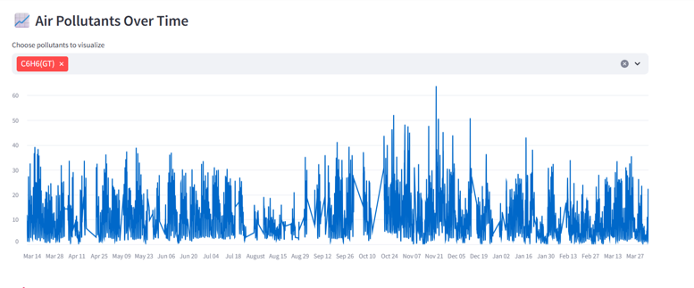

Slide 14
THANK YOU
THE END

